Slide 1

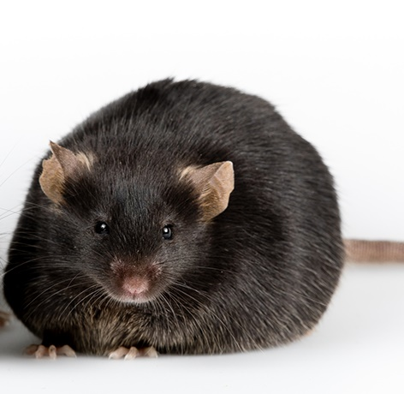
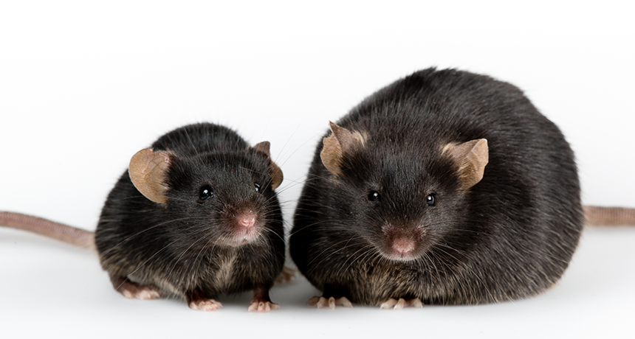
Intro
© Jianhua Shao
Gérard, 2017
Notes:
Let’s start with an example most of you know. So we have two mice in the lab, one obese one and one normal one. When we transplant the microbiome of the obese mouse to a normal mouse, the normal mouse becomes obese.

Slide 2
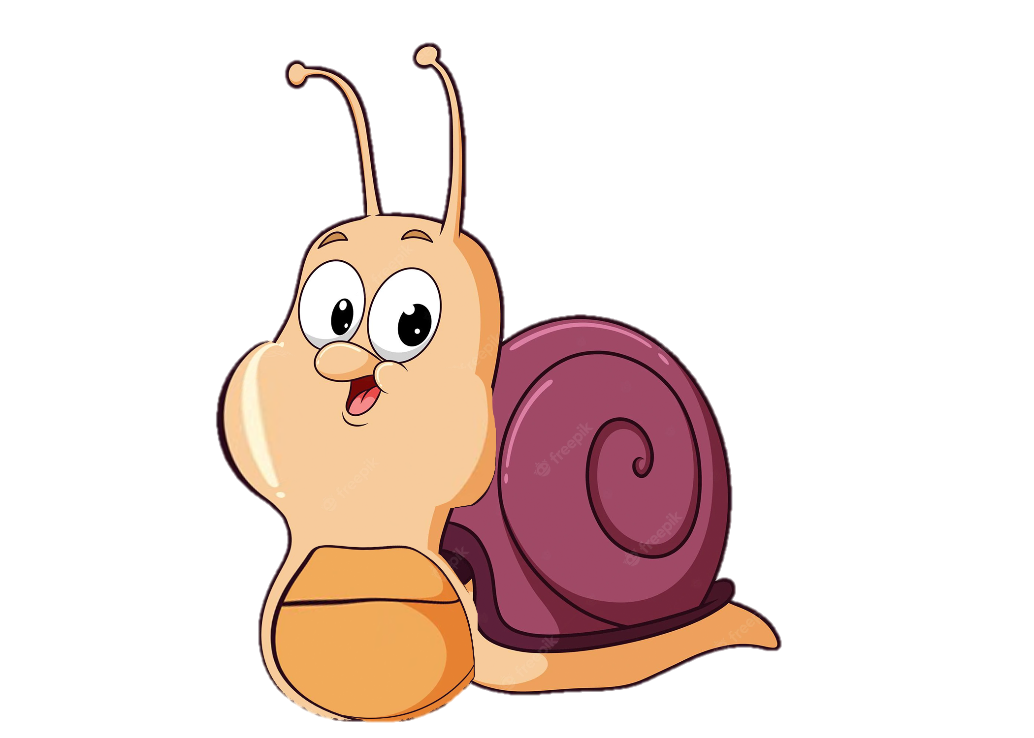
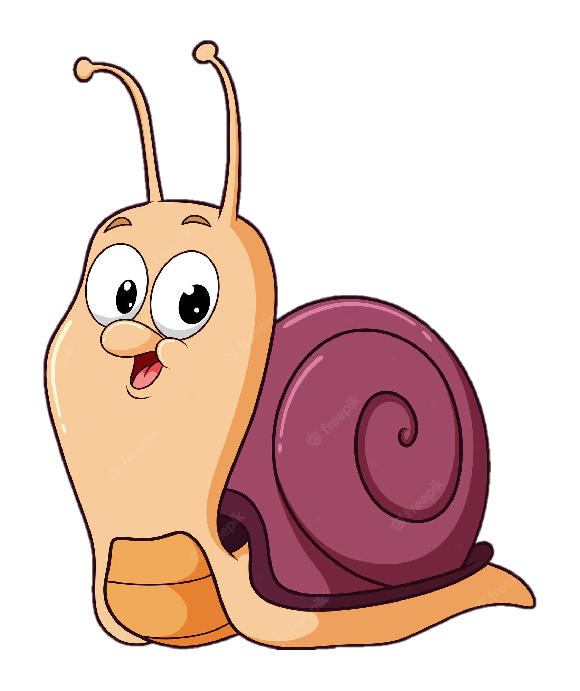
Intro
???
Notes:
Very simplified: In the microResist project we want to see if we can’t turn a normal snail to an “obese” version too by manipulating the microbiome?

Slide 3

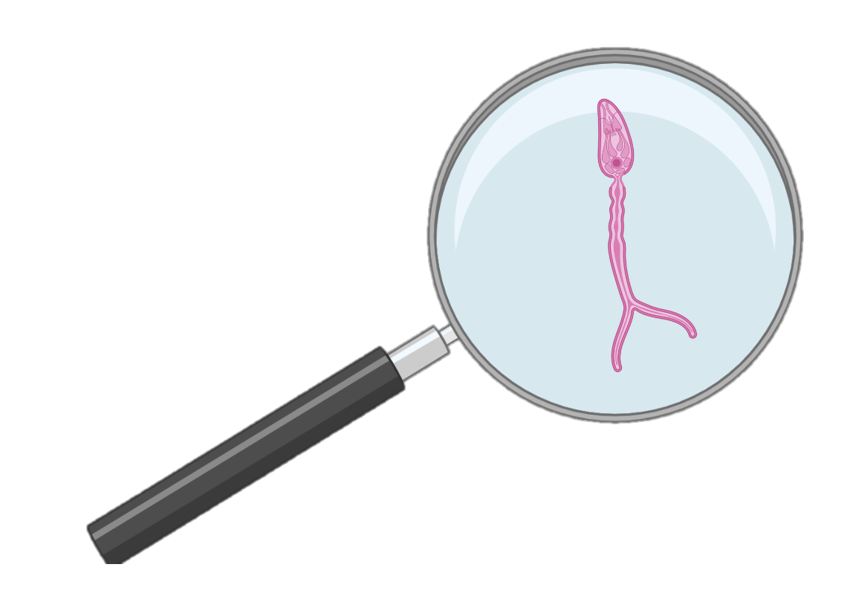
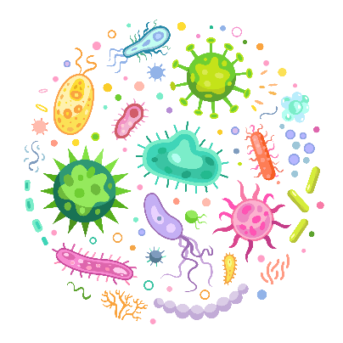
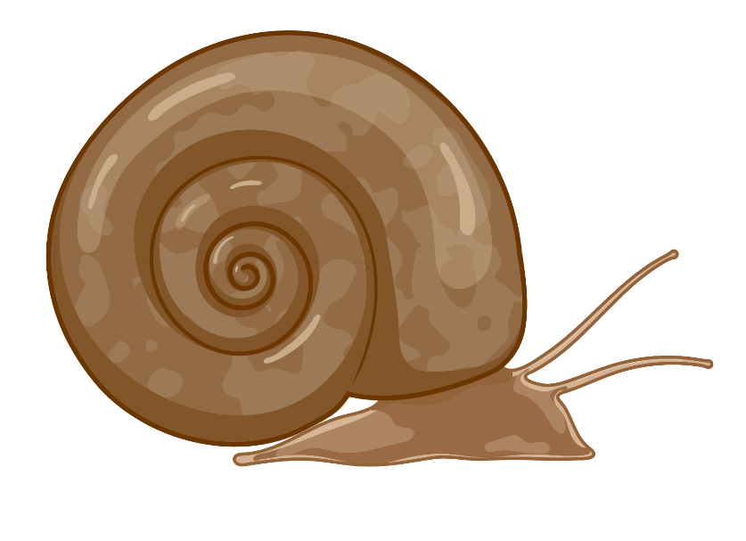

MicroResist - The influence of snail host microbiome in trematode parasite resistance
PhD student: Ruben Schols
Promotor: Prof Ellen Decaestecker
Co-Promotor: Dr. Tine Huyse

Slide 4
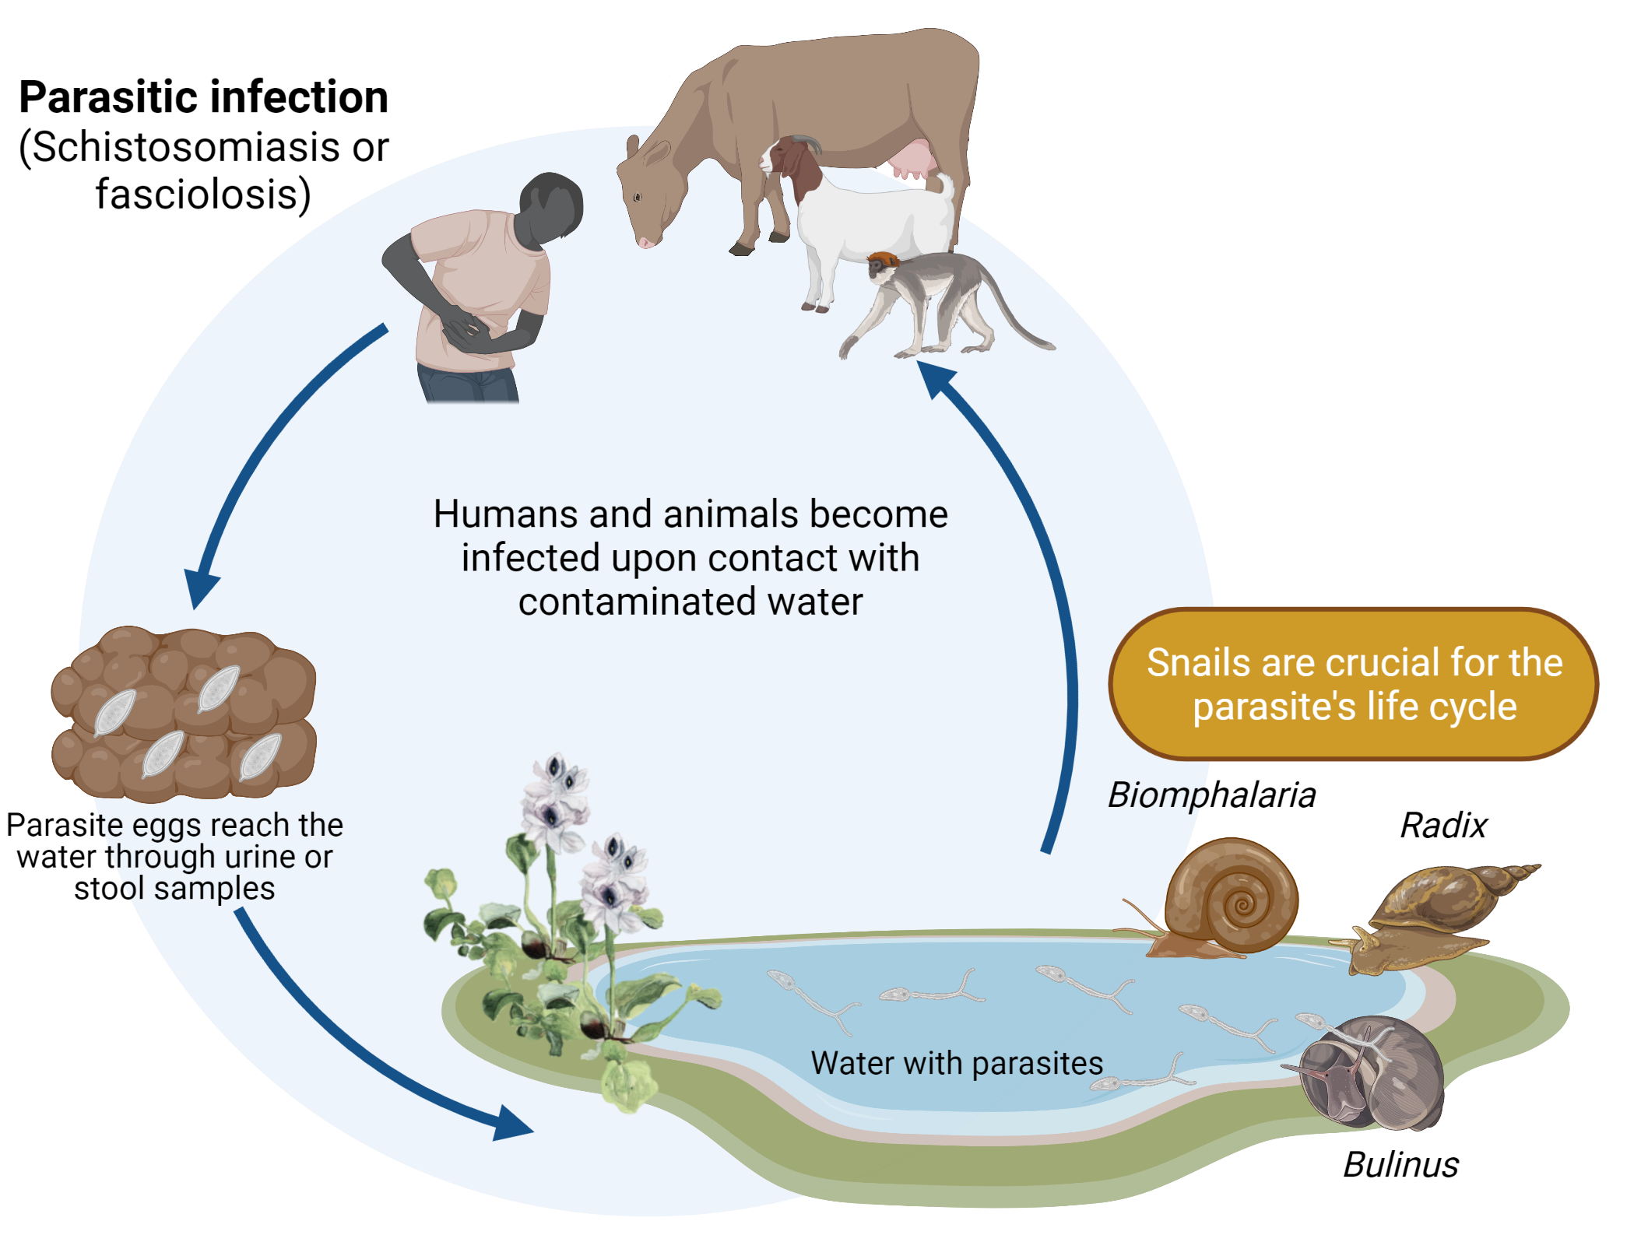
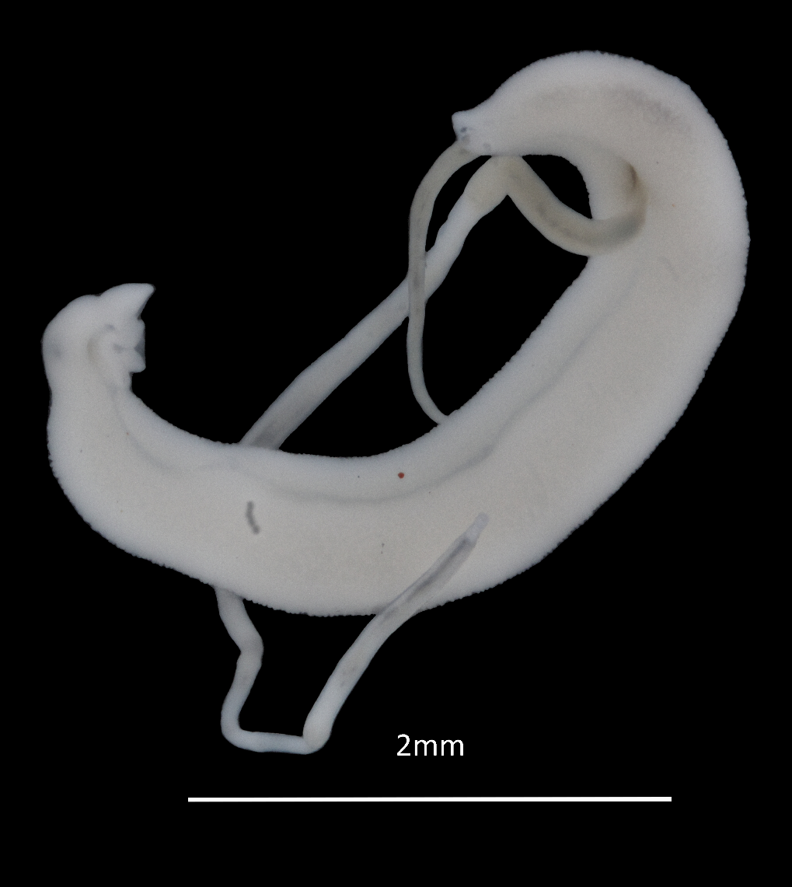
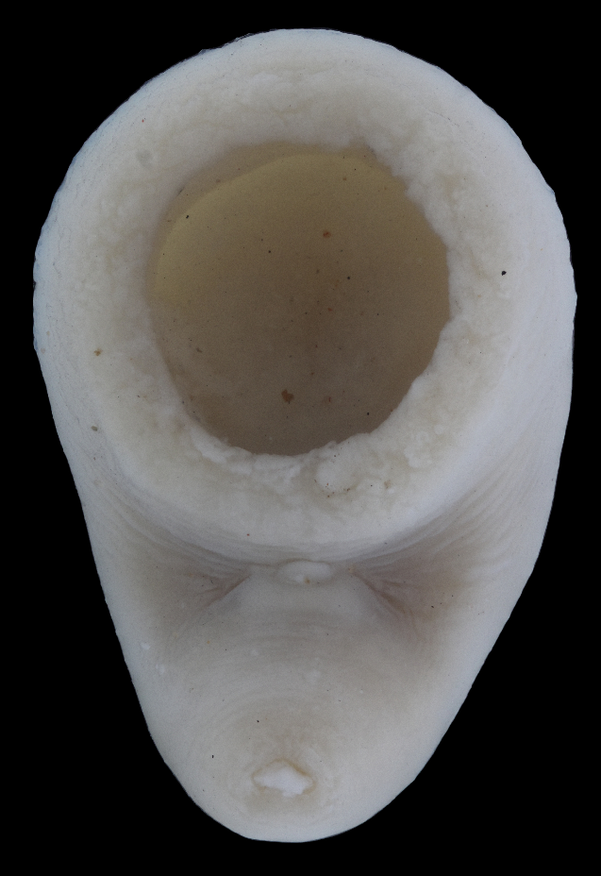
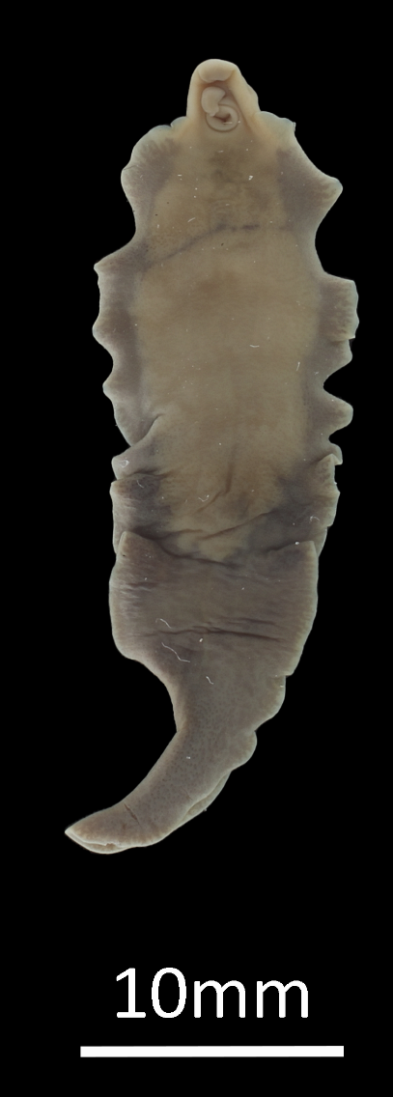

Trematodes
Intro
Notes:
To understand why we want to make these “obese” snails we’ll need a bit of background.

Slide 5
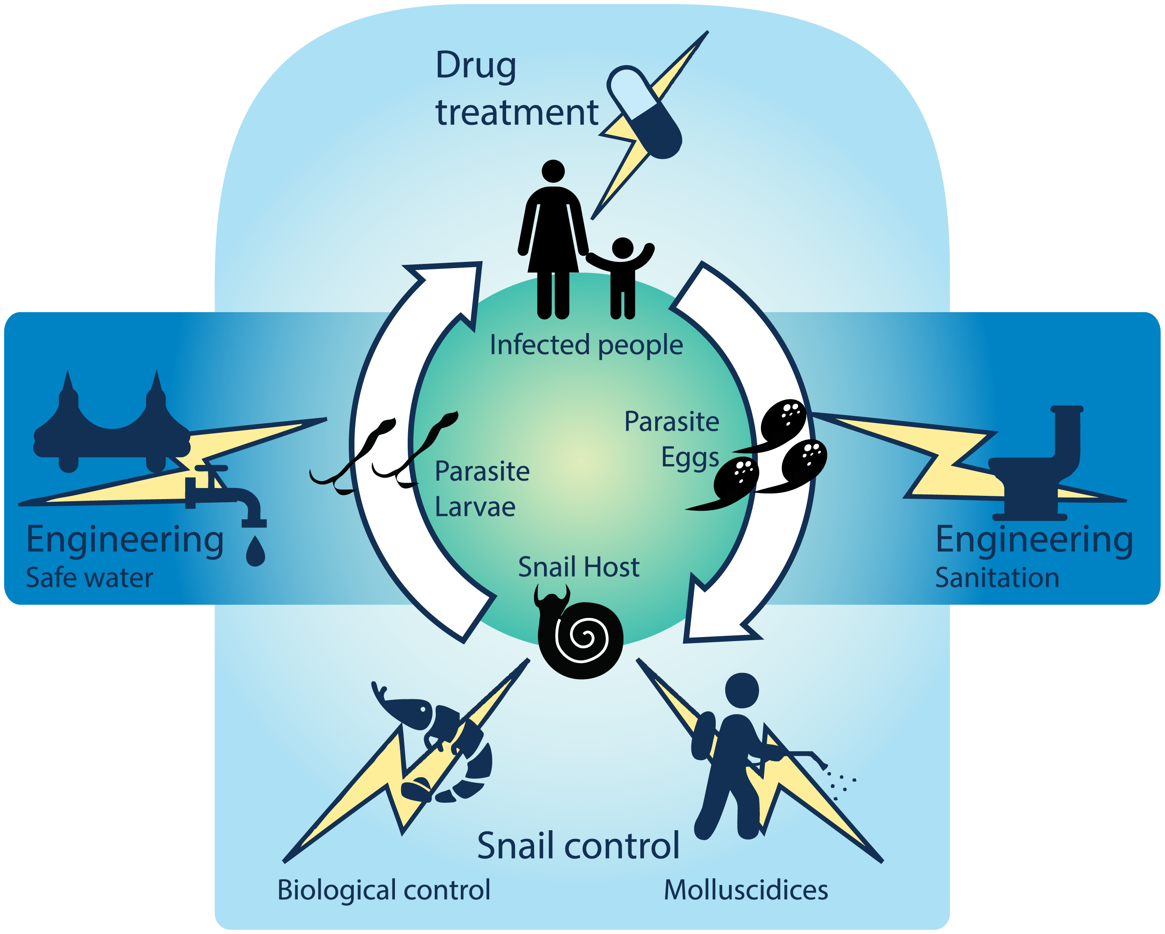



Problem outline
Intro
Millions affected
Control measures
  Limited success
  Not sustainable
Microbial solution

Slide 6






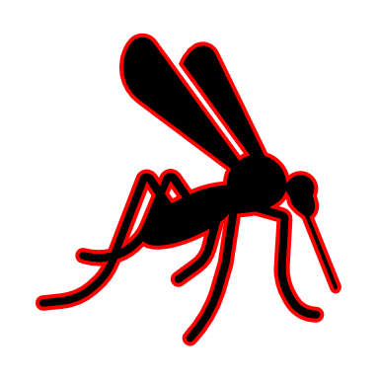



Tripartite interaction
Intro

Slide 7
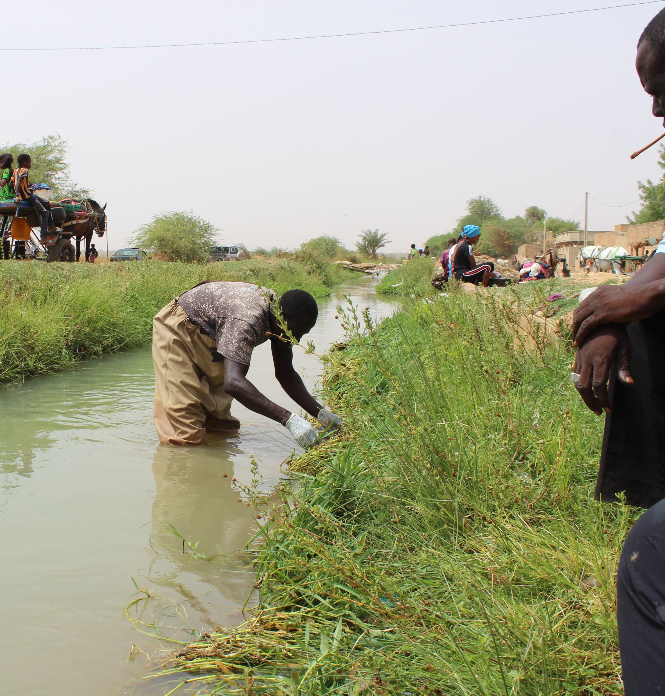
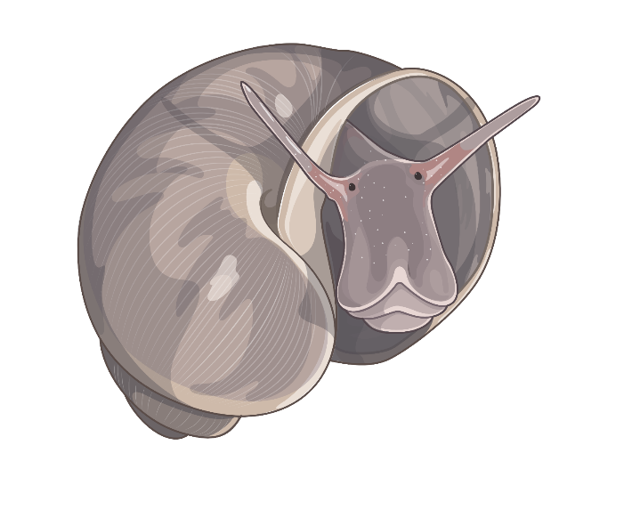
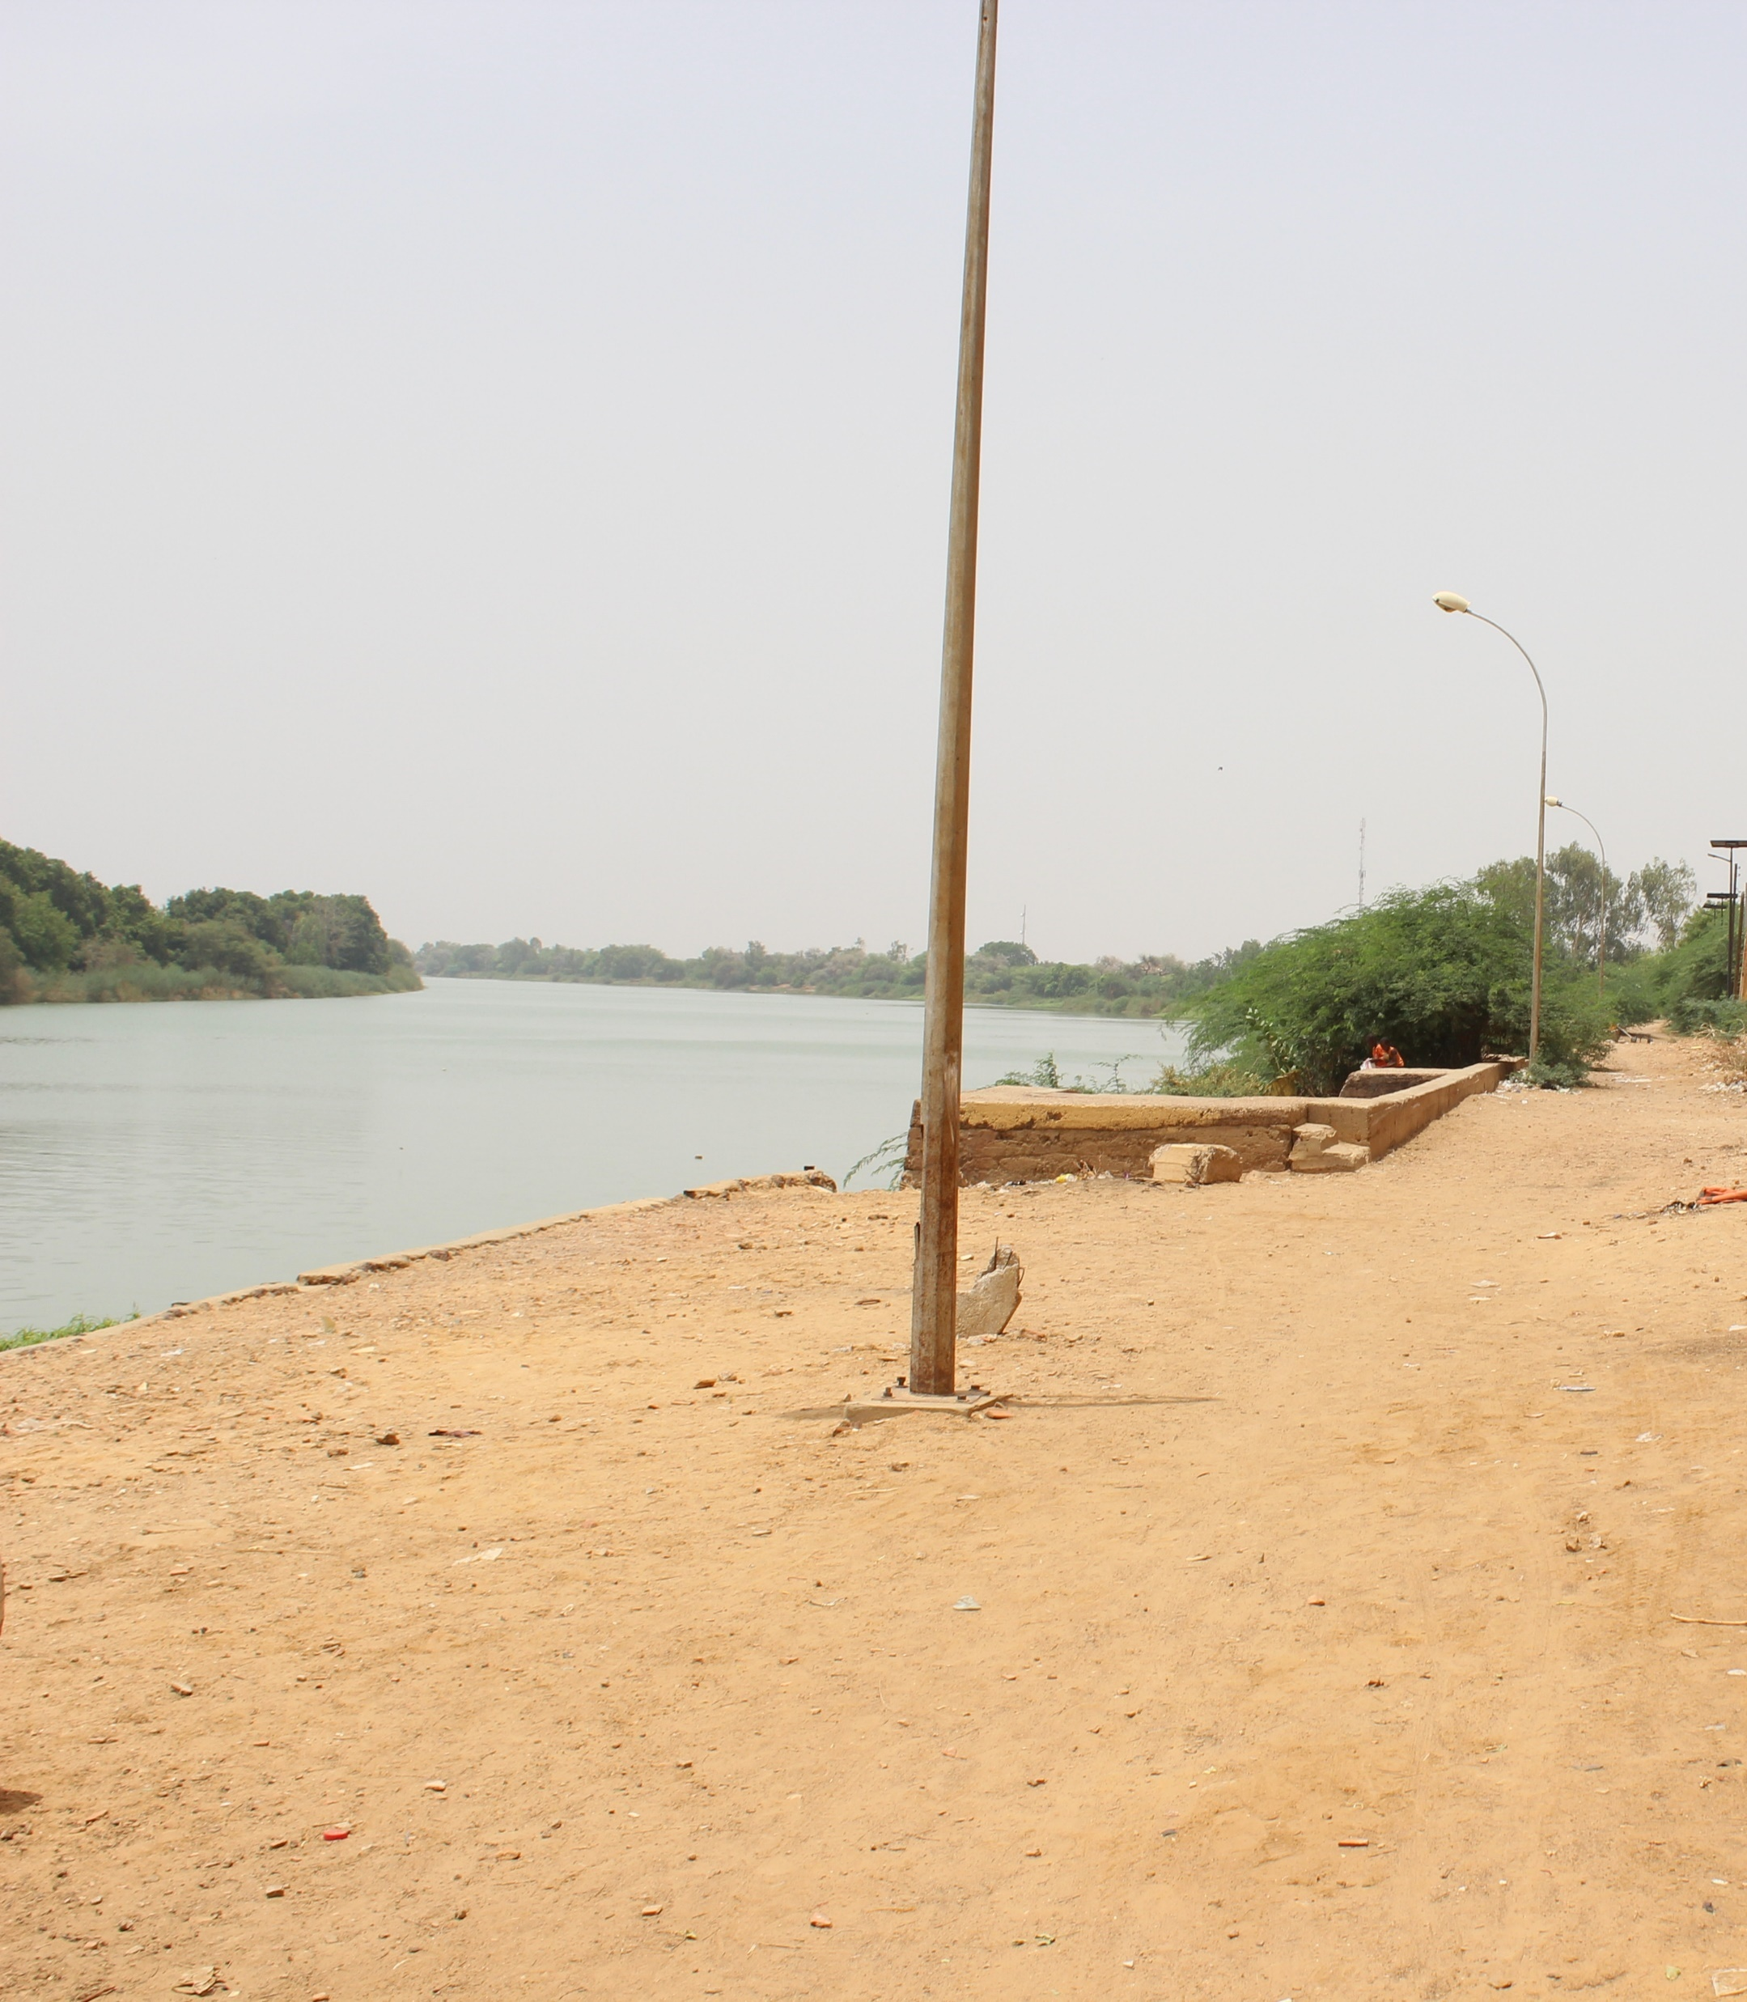

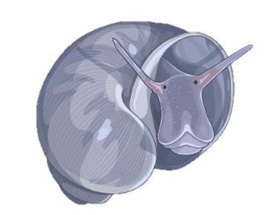
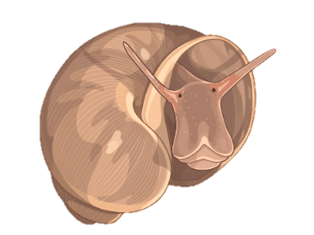
TRISS
Notes:
Now that you all have some more background knowledge, you can join me for sampling in Afrika. Imagine you are collecting snails in the field. You are out there in the blistering sun, gummy boots full of your own sweat, scooping for snails as if your life depended on it. It turns out that there is two snail species present. Besides a few external differences, They are quite closely related. How is it then that snail number 1 transmits a deadly human parasite, while snail number 2 is harmless and does whatever snails do best? Moreover, something crazy happens, If you would go and collect snails from that same waterbody a few miles upstream, you would be surprised to find out that the tables have turned. Now snail 2 transmits the deadly parasite while snail 1 became harmless.

Slide 8
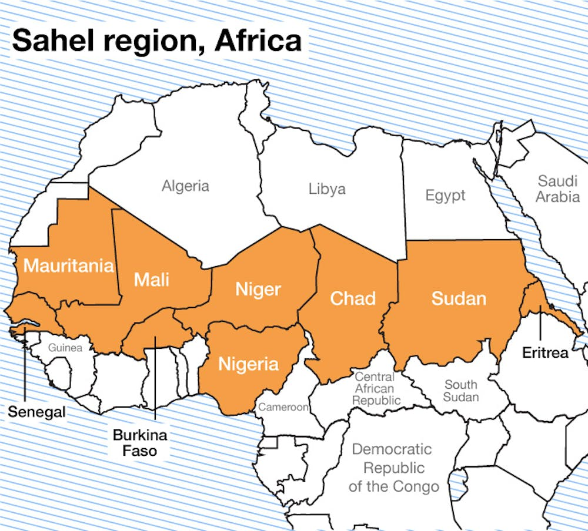
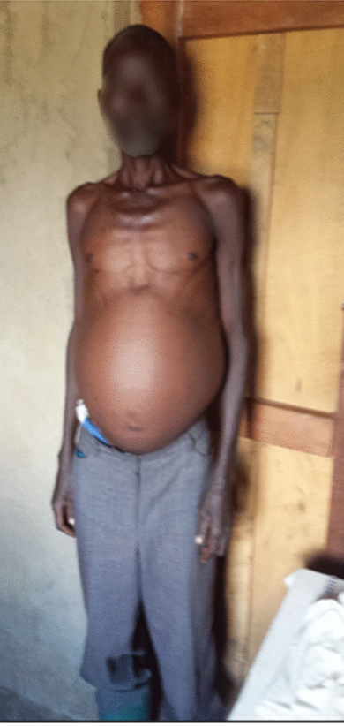
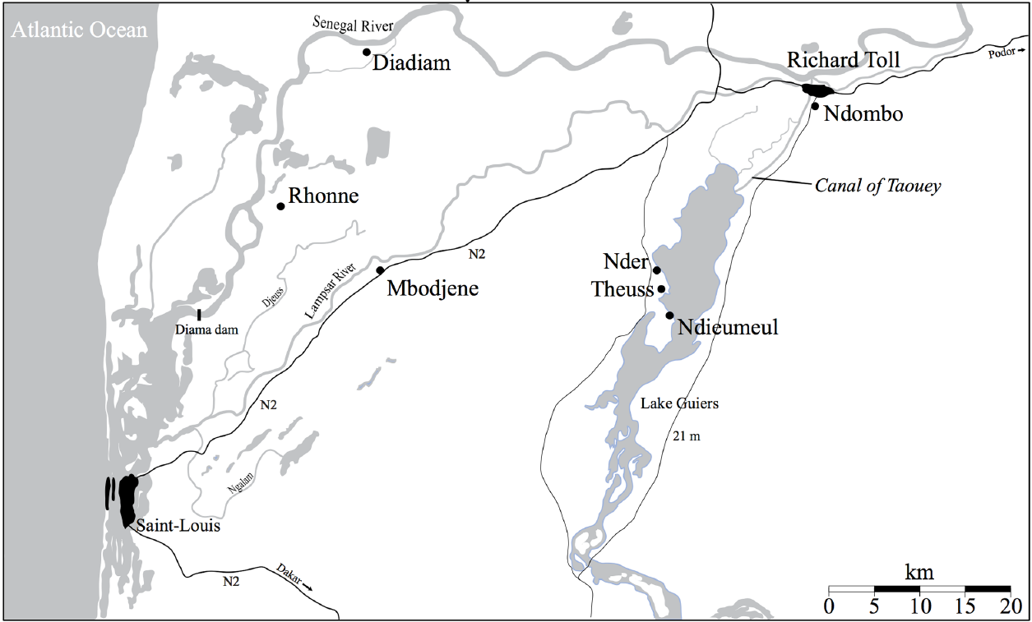
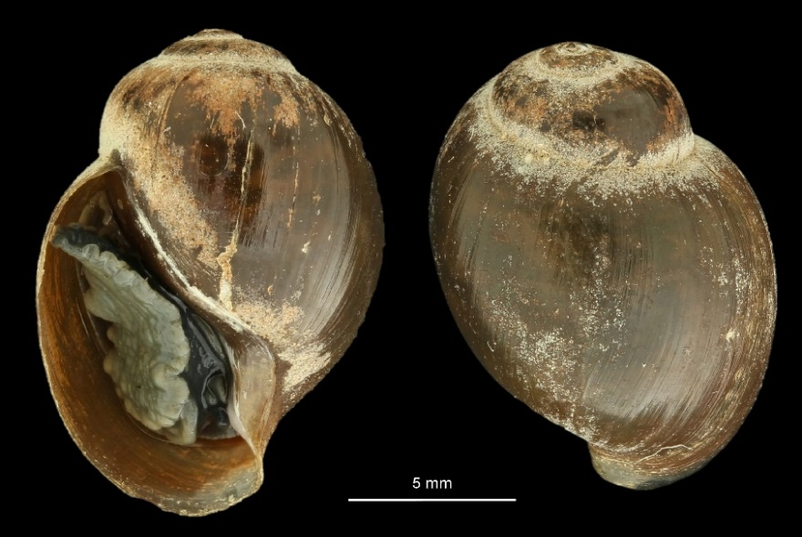
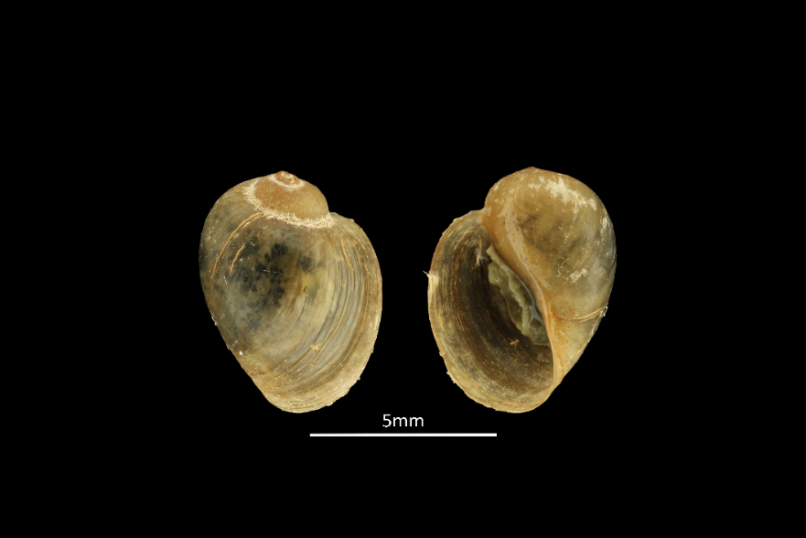
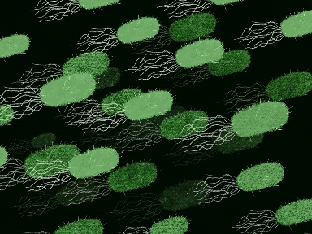
TRISS - Towards a better understanding of the tripartite interactions driving Schistosoma transmission in Senegal
TRISS
Bulinus globosus
Bulinus truncatus
Nigo et al. 2021
The Conversation/Zenobia Ahmed
Notes:
This is what is happening in the Senegal River Basin! Snail number 1 is B. globosus, Snail number 2 is B. truncatus and the deadly disease I am speaking of is schistosomiasis.
So why Senegal. To understand this, we need to know a bit more on the background of the region. Senegal is located in the sahel region, making it prone to droughts and famines. To ensure water availability yearround two dams were built. One of them being the Diama dam to limit salt water intrusion upstream completed in 1986. This looked like a successstory but then schisto came around and it became one of the worst schisto transmission foci to this day.
So why is one snail compatible the other not, and hwy does this change throughout the basin? Exposure experiments possibly indicate that snail and parasite genetics might play a role but results are still inconclusive. Perhaps the microbiome could offer a new perspective on this system.

Slide 9
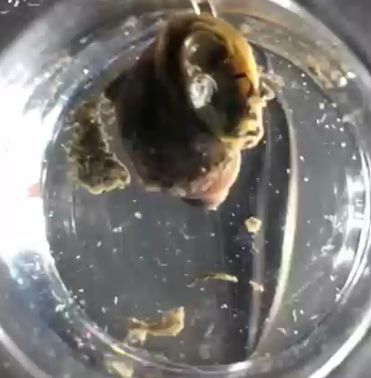
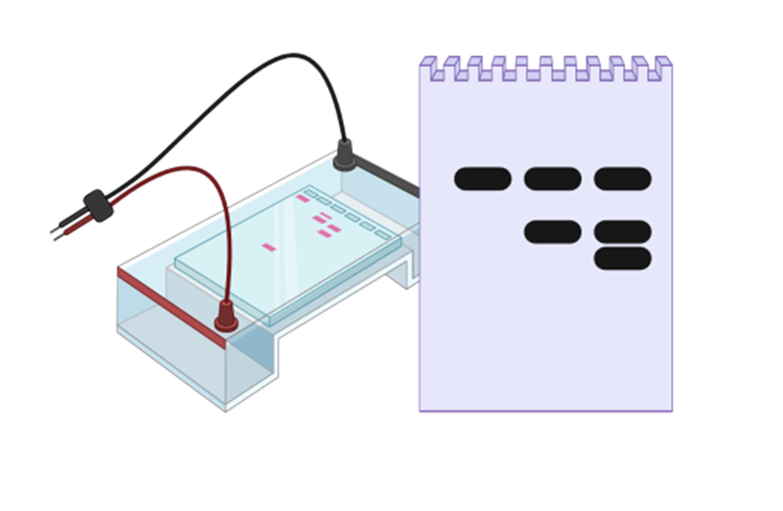
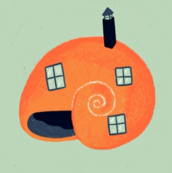
Methodology
TRISS
Hammoud et al., 2021
High-Throughput
Amplicon Sequencing
INFECTED
UNINFECTED
ALL
Shedding experiment
Infection RD-PCR
16S metabarcoding
Schols et al., 2019
Sanger sequencing

Slide 10
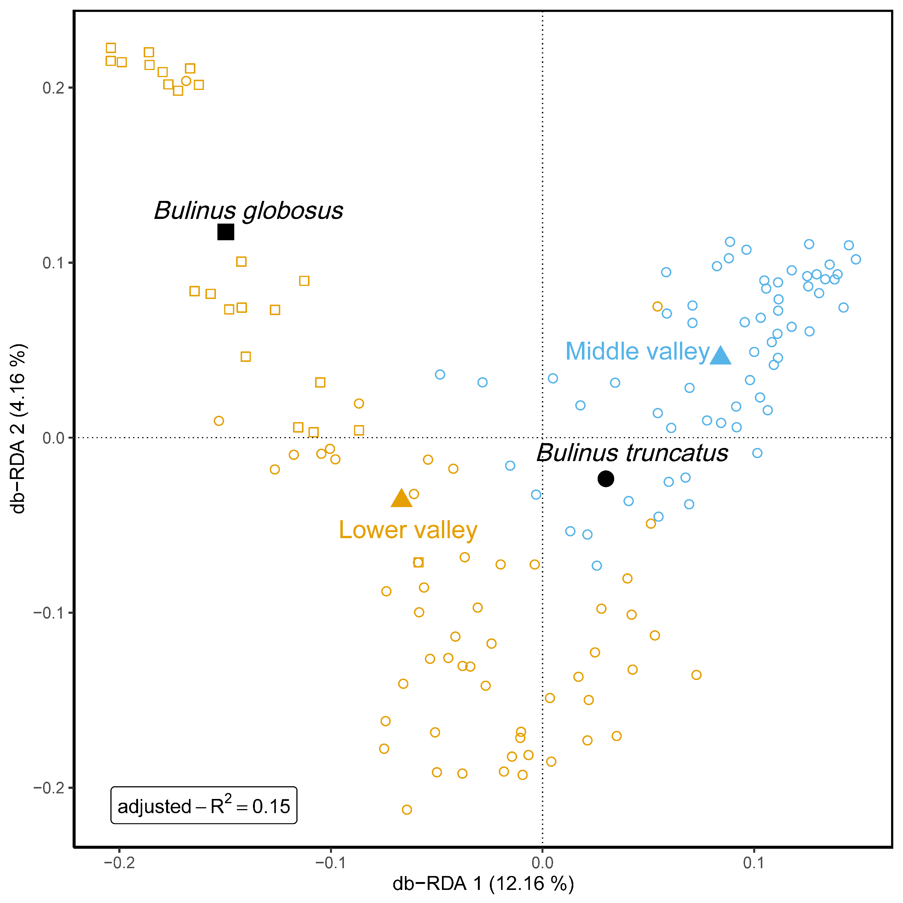
TRISS
Notes:
The RDA analyses shows us that the microbiome differs between the middle and lower valley while also showing the difference between the two species. This could have profound implications for disease transmission across the SRB. Interestingly, the analysis can also be used in the opposite direction. Instead of using the metadata we have to better understand the microbiome patterns, it helps detect erroneous species identifications in the snail samples. There is a circle in the middle of BGL and a square n the middle of TRU. We also see an orange circle in the middle of the blue. This triggered me to go and have a look again at the snail pictures and behold, the RDA-plot was actually correct and thus helped with the species ID.

Slide 11
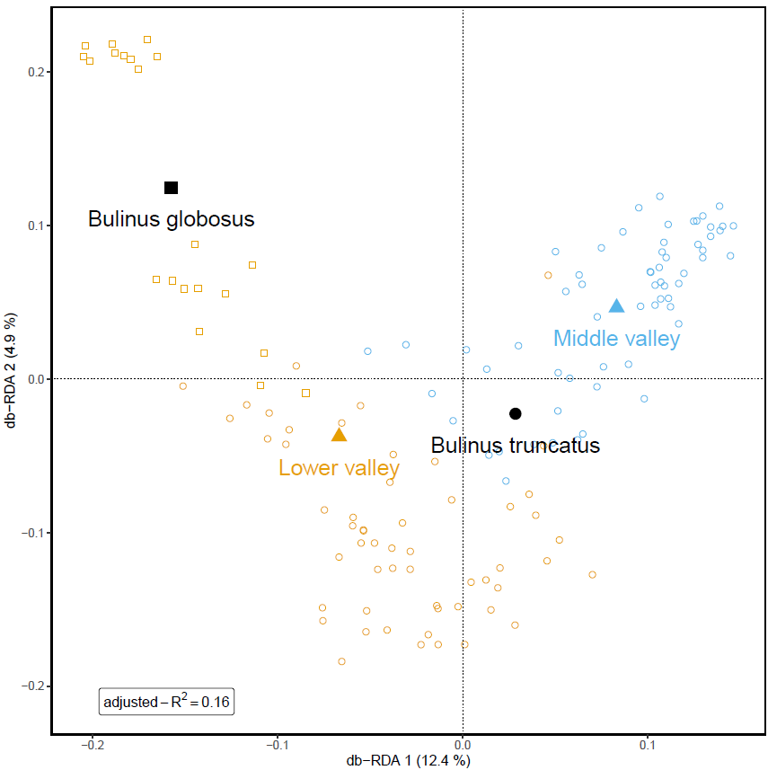
TRISS
Notes:
How could this happen? Masterstudents were trained for snail species ID on a training set based on morphology but it is not always easy to differentiate the two species in Senegal. Hence, the potential for errors and the need for DNA-barcoding to ascertain species ID.
The wrongly placed site in the RDA plot is not easily solvable and most probably is true variation.
Including the infection YES/NO is not enough, it only provides 0.5% extra information to the model. But when looking at schisto/trem/non information becomes significant!. So with the HTAS approach we might get to a meaningful level of explanation in the model because the different schisto and trem species will be resolved as well as the single and co infections.

Slide 12


Causation VS correlation
Transplant experiment
  Can we make Biomphalaria glabrata axenic?
  How do time until exposure and the phylogenetic distance to the donor affect survival?
  Can we transplant a microbiome in these axenic snails?
Axenicity
Survival
Transplant

Slide 13
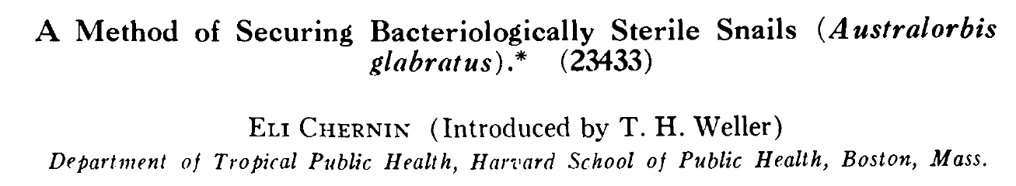
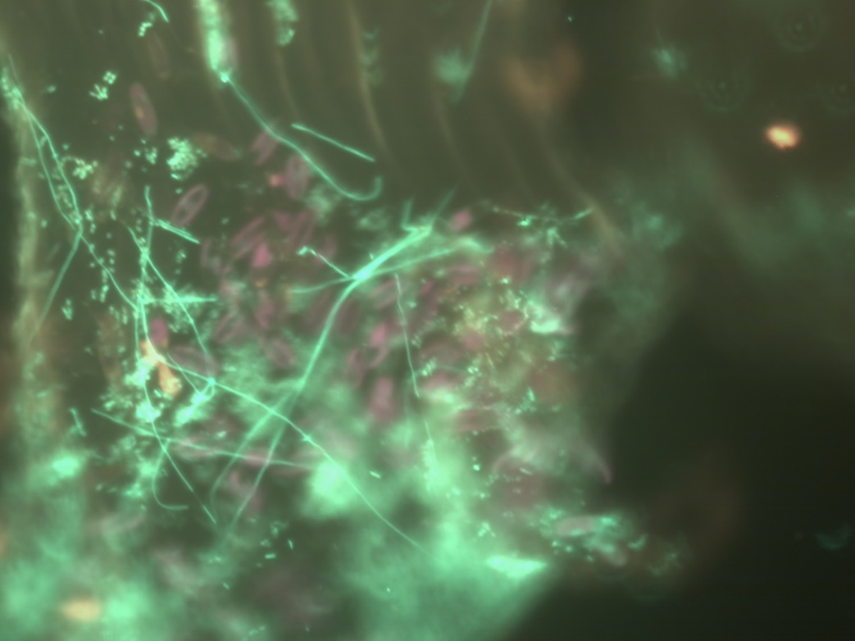
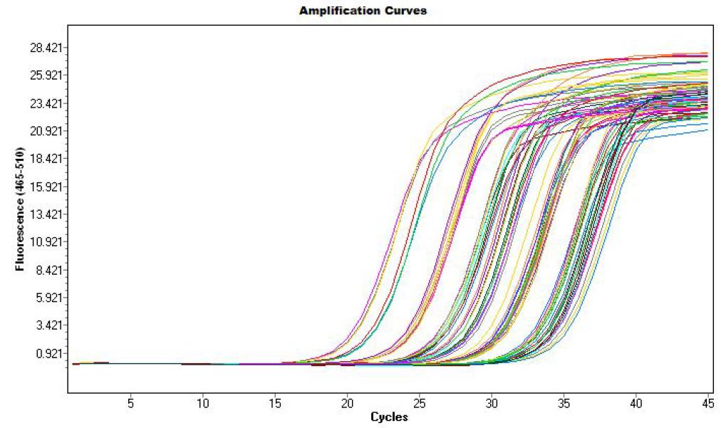
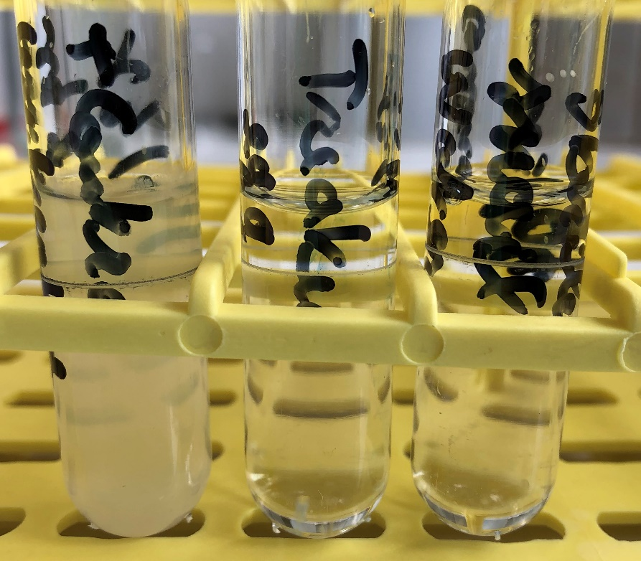
Transplant experiment
Axenicity
The need for a sterilization protocol
  Chernin 1957

Slide 14
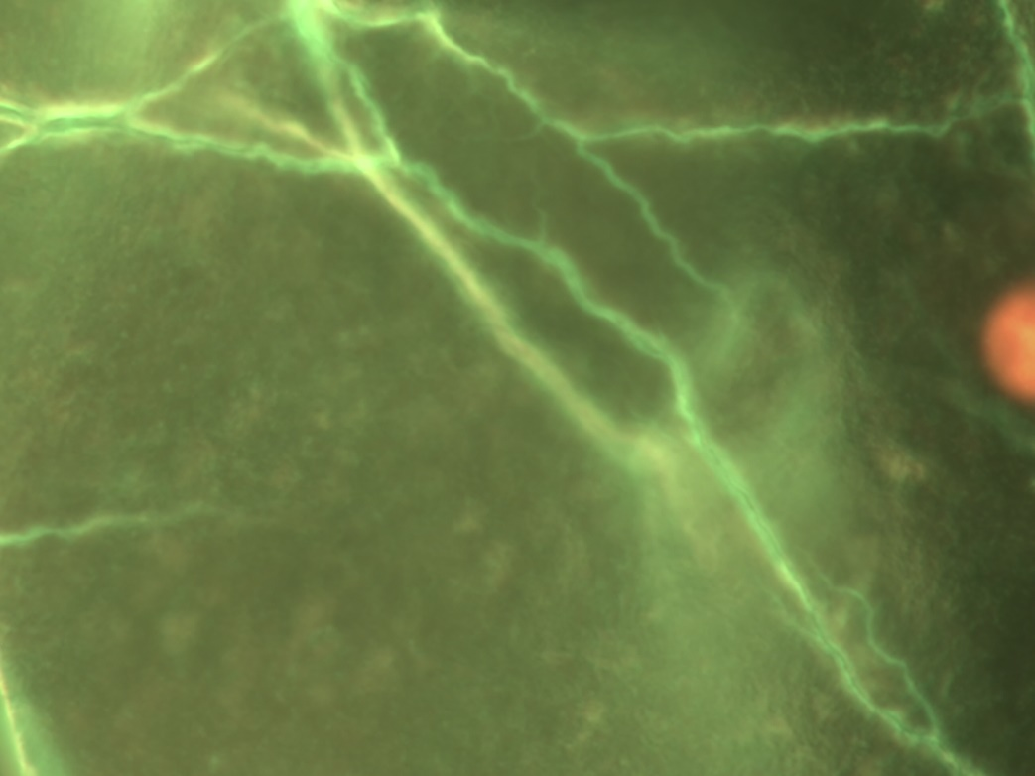

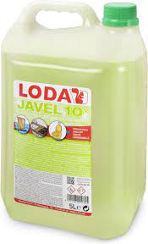
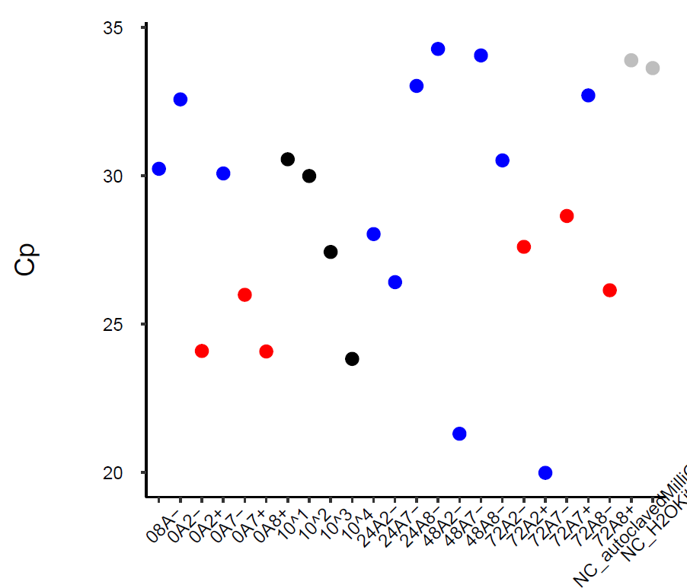


Transplant experiment
Axenicity

Slide 15
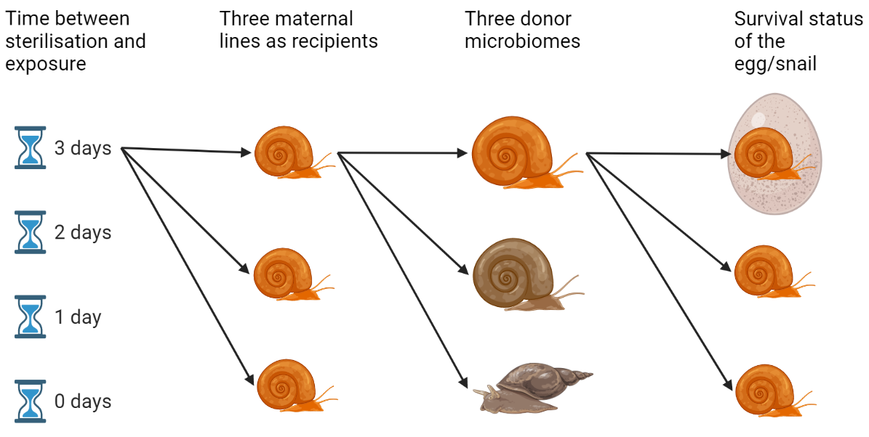

Experimental setup
Surv. + transplant
GLA
Egg
PLA
Hatched
LYM
Dead

Slide 16
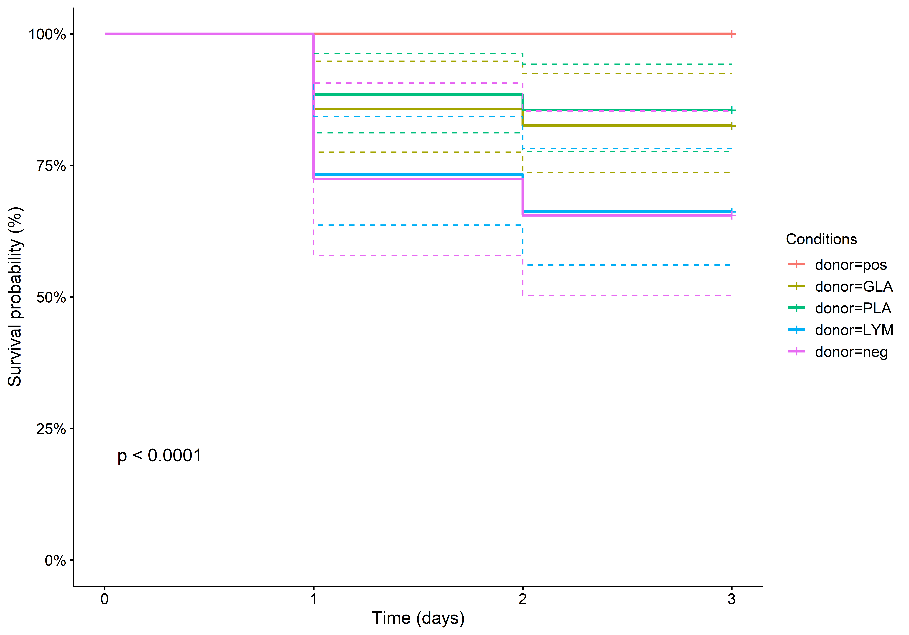
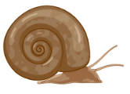


survival
Notes:
excluding snails dead at d0 while removing those still in the egg at the end

Slide 17
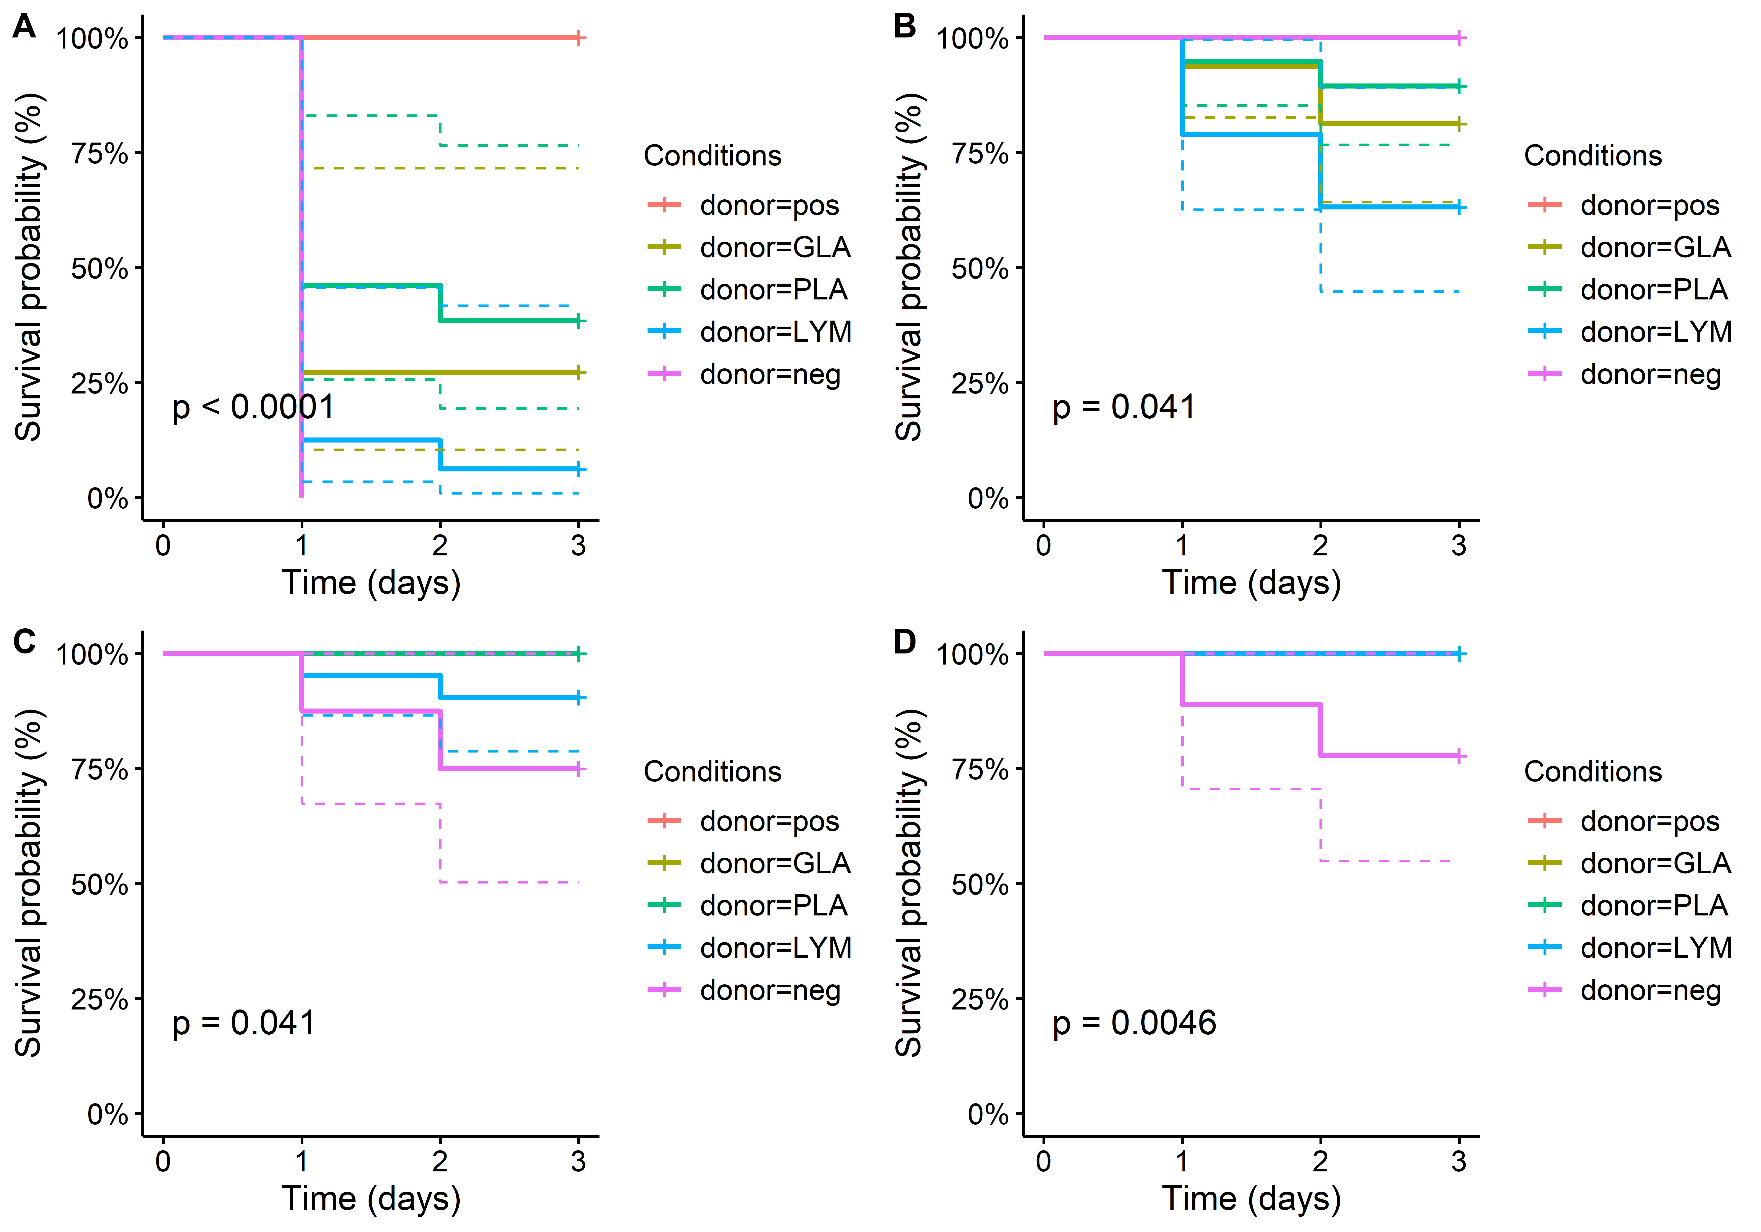



0h
24h
Survival
48h
72h
Notes:
excluding snails dead at d0 while removing those still in the egg at the end

Slide 18
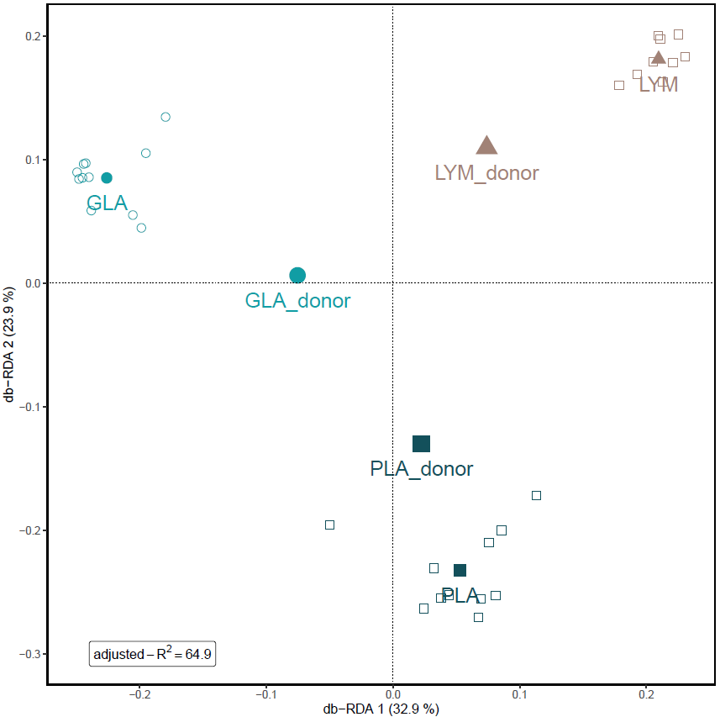
Transplant

Slide 19
Core microbiome
Transplant
3 Families shared between GLA ( ), PLA ( ) & LYM ( )
    Pseudomonadaceae
    Comamonadaceae
    Flavobacteriaceae
  Abundance core taxa 49% +-12%
Family Pirellulaceae occurred in all but one ‘neg’ ( ) sample
    Candidate for vertical transmission?
  Abundance core taxa 32% +- 28%
2/3 also shared with ‘pos’ ( ) samples
Notes:
These core taxa might be crucial for snail survival since they make up the majority of the microbiota even with different donor microbiomes. The fact that they do not show up in the negative samples shows that they cannot have been transferred vertically.
(0.01 & 0.95):
(0.01 & 0.85):
Flavobacteriaceae
Comamonadaceae
Pseudomonadaceae
Family Pirellulaceae
Only one sample had 1% de rest had 10% or more.
Planctomycetes of the family Pirellulaceae are commonly addressed as budding aquatic bacteria with a complex lifestyle.

Slide 20



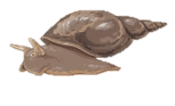

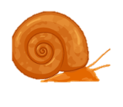
Concluding remarks
Ubiquitous core microbiome
Microbiome possible driver of snail susceptibility
‘Obese’ snails might be possible
Notes:
COME BACK TO THE OBESE SNAILS!!
Is the microbiome responsible for disease pattern in Senegal?
Will a transplant experiment show that it can protect snails?

Slide 21



Special thanks to:

Slide 23
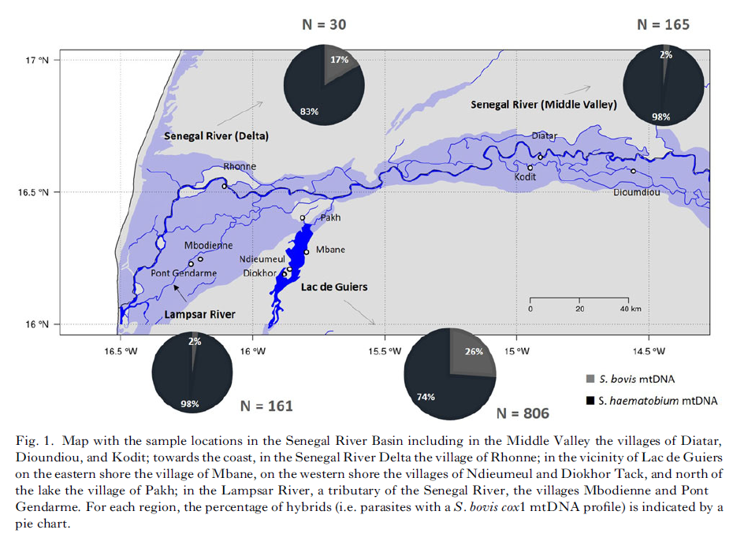
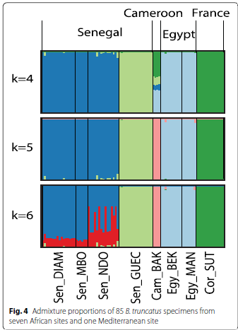
Boon et al 2018
Maes et al 2022
Notes:
Southgate 2000:
TRU all across SRB not susceptible to S. haem from BGL (lower valley)
TRU all across SRB susceptible to S. haem but just not from Senegal
Boon:
Suggest that the absence of BGL in the middle valley could be the driver of the lack of hybrids there. But Why is there then also few hybrids downstream?
Maes:
DIAM, MBO, NDO Lower valley
GUEC Middle valley
Suggest that this might correlate to the lack of S. haem by B. truncatus in the lower valley.
S. Haem diversity super low. Contrasting the high diversity in S. mansoni, which allowed it to spread so quickly across the SRB

Slide 24
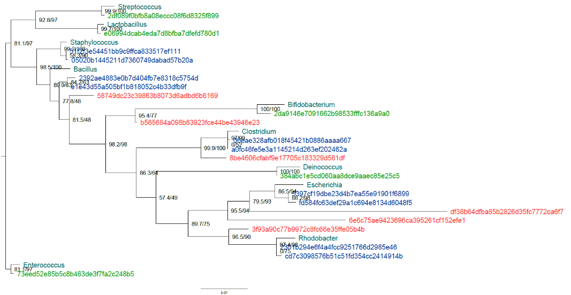
Reference strains
Clear ASVs
+-OK ASVs
Bad ASVs
BAD ASVs: Cluster alone and do not match expected species
GOOD ASVs: cluster close to the expected species alone
OK ASVs: cluster close to the expected species but not alone
TO DO: Want to get rid of the BAD ASVs while maintaining the GOOD (and OK) ASVs

Slide 25
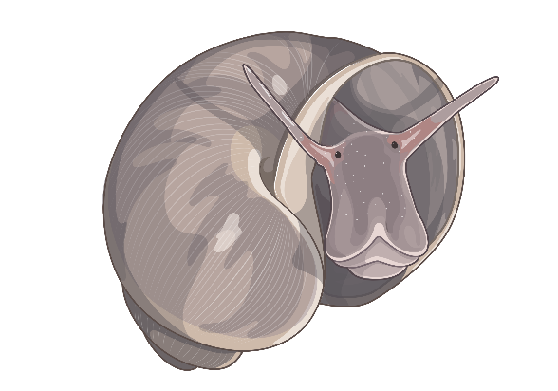
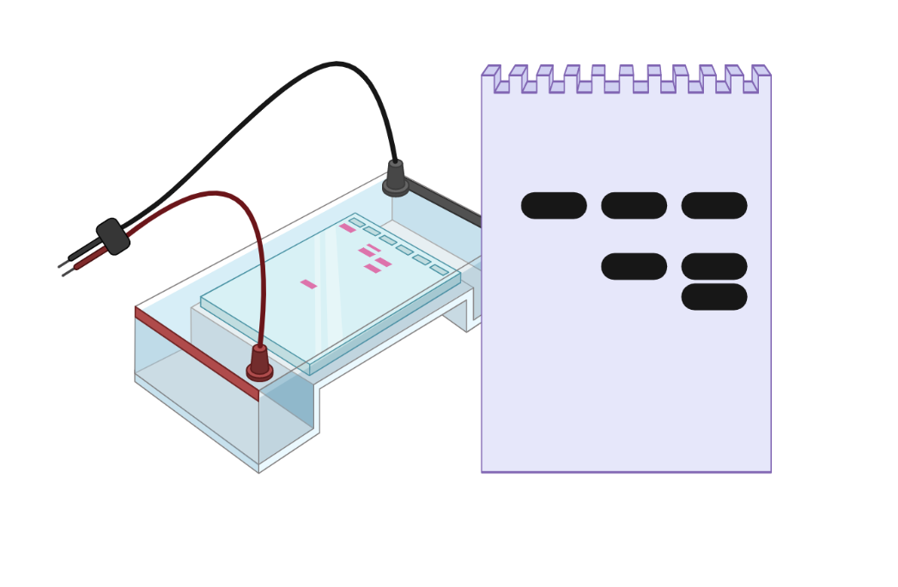
Infection RD-PCR
Determine infection status
Two-step
Schols et al., 2019
Snail marker
Trematode marker
Schistosoma spp. marker
Schistosoma sp. infected
Trematode infected
Non-infected

Slide 26
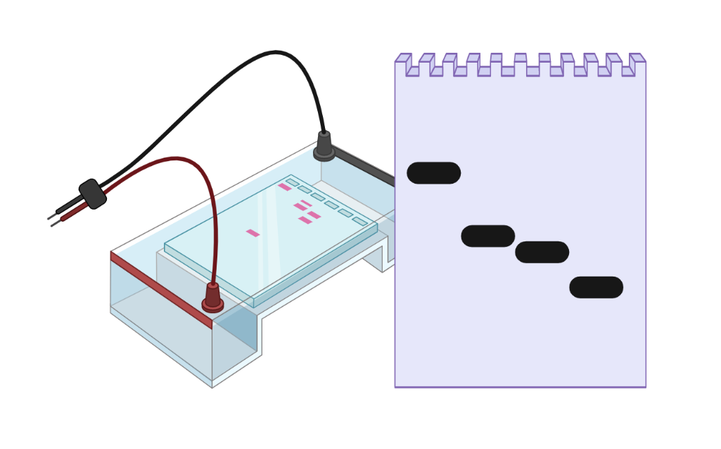
Schistosoma RD-PCR
Two-step
Identify Schistosoma species based on COX1
S. haematobium
S. mansoni
S. mattheei
S. bovis / S. curassoni / S. guineensis
Adapted protocol from:
Webster BL, Rollinson D, Stothard JR, et al. Rapid diagnostic multiplex PCR (RD-PCR) to discriminate Schistosoma haematobium and S. bovis. J Helminthol. 2010;84(1):107–14.
Van den Broeck F, Geldof S, Polman K, et al. Optimal sample storage and extraction protocols for reliable multilocus genotyping of the human parasite Schistosoma mansoni. Infect Genet Evol. 2011;11 (6):1413–8.
Schols et al., 2019

Slide 27
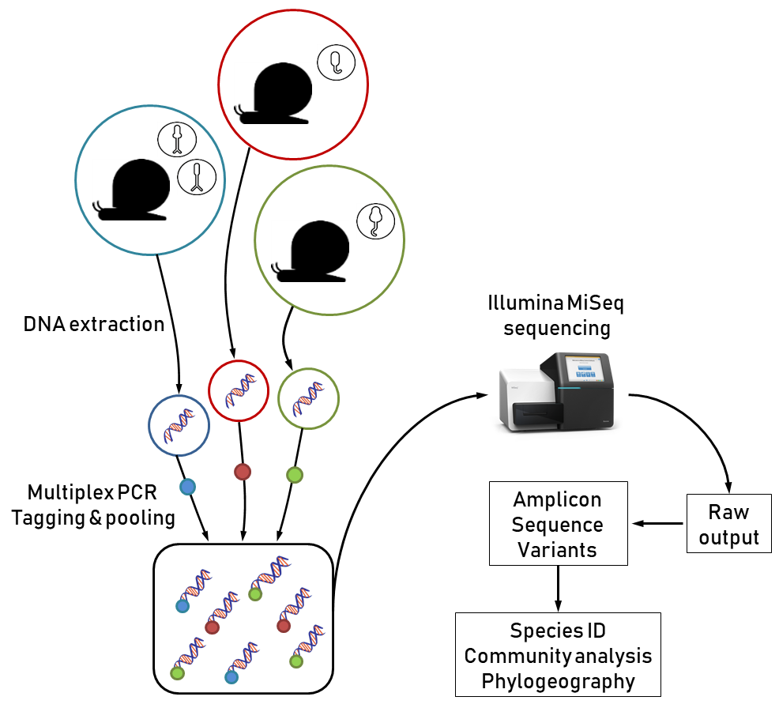

Further analysis - HTAS
Hammoud et al., 2022

Slide 28
Further analysis - HTAS
COI1
COI2
ITS2
cytb
NAD1
COI1
COI2
ITS2
cytb
NAD1
Primer amplifi-cation
70%
40%
100%
30%
90%
0%
90%
0%
40%
100%
0%
0%
100%
0%
0%
COI1
COI2
ITS2
cytb
NAD1
1. For each marker: species delineation using ASAP (+ GenBank sequences for validation)
2. Linking markers together using frequency of co-occurrence in snails
3. Validating some profiles using Sanger sequencing on field collected cercariae
Species puzzling
Observed
profiles

